Slide 1
State Management with Provider
Improve your app using Provider

Slide 2




Sobre o Palestrante
Diego Velásquez López
Google Developer Expert Flutter
Software engineer
Android / iOS / Flutter
Creator of 2 Android apps (+100k downloads):
Pseudocode
Quick Printer
Founder & Organizer @ Flutter Peru
@diegoveloper
Mobile Software Architect
https://aeyrium.com

Slide 3
Cronograma
What, Why, How
Live Code
Provider
Summary

Slide 4
What is State Management?

Slide 5
Why?
Keep UI separated from business logic.
Increase the performance of your app.
Allows adding features quickly without breaking the code neither sacrificing code quality.
Easy to understand; hard to break.
Easy to test.

Slide 6
How
Using setState() and StatefulWidgets
ScopedModel
Provider
BLoC (Business Logic Component)
Redux
MobX

Slide 7

Let’s code

Slide 8
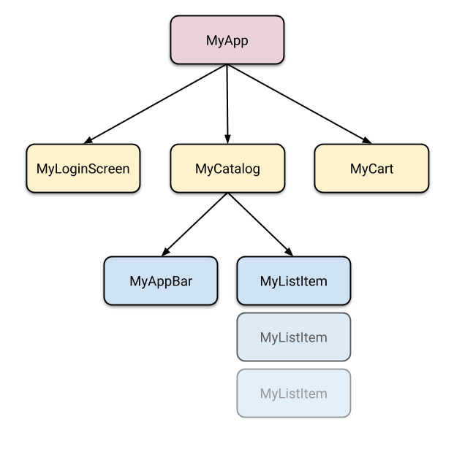

Slide 9
Provider
https://pub.dev/packages/provider
Expose/Provide
Read/Listen

Slide 10
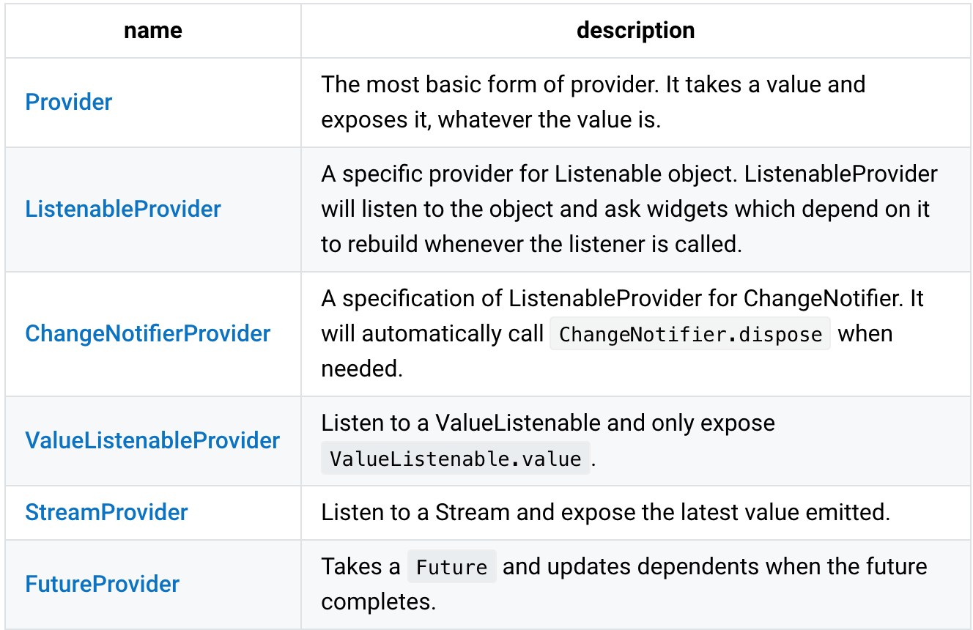
Expose/Provide

Slide 11

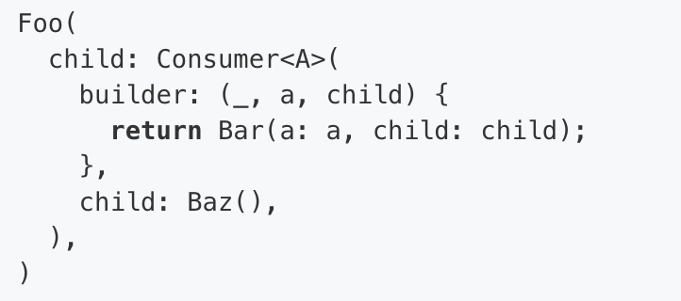
Read/Listen

Slide 12
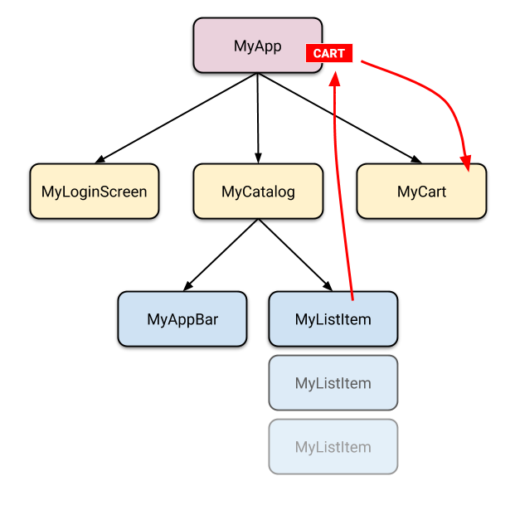
ChangeNotifierProvider
(CartModel)
(Get Cart Items)
(addItem)

Slide 13
Summary
There’s not right or wrong solution.
Choose the one that best suits your needs.

Slide 14

Perguntas e Respostas
diegoveloper@gmail.com
https://github.com/diegoveloper/
https://medium.com/@diegoveloper
https://twitter.com/diegoveloper

Slide 15
Obrigado!

